Slide 1
Computer Organization & Assembly Language (CSC-236)
Lecture 11

Slide 2


Slide 3
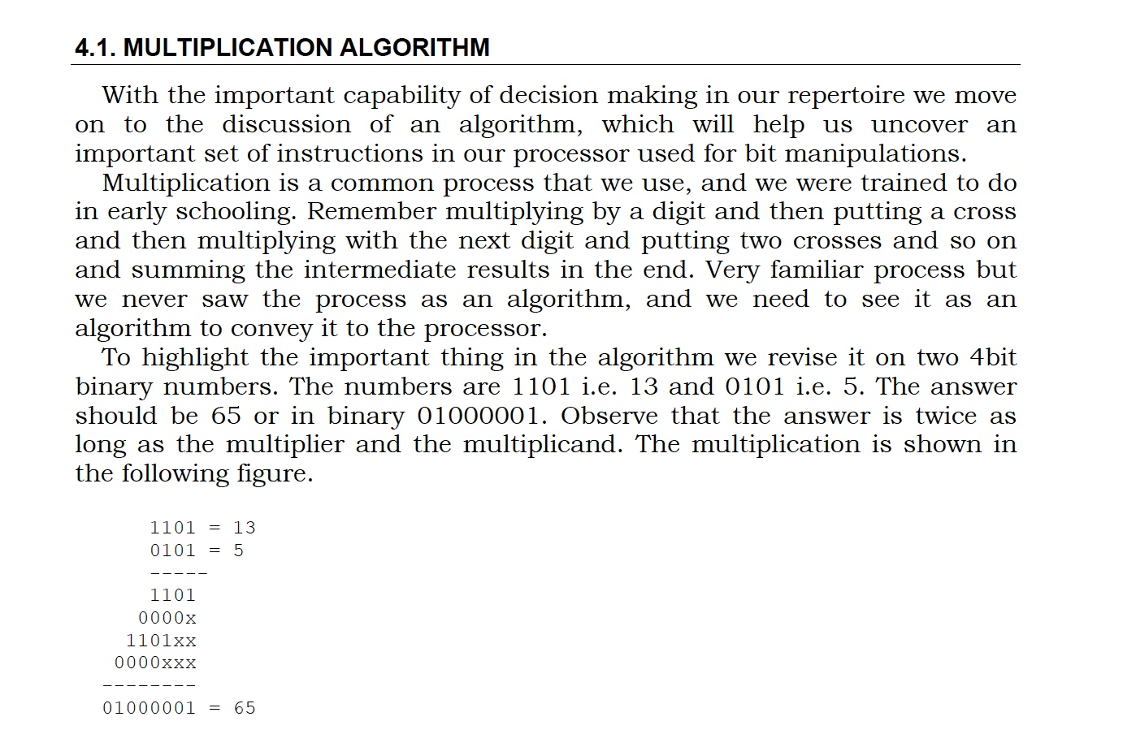

Slide 4
4.2. SHIFTING AND ROTATIONS
The set of shifting and rotation instructions is one of the most useful set in any processor’s instruction set
They simplify really complex tasks to a very neat and concise algorithm
The shifting and rotation operations which are available in our processor are mentioned in the next slide

Slide 5
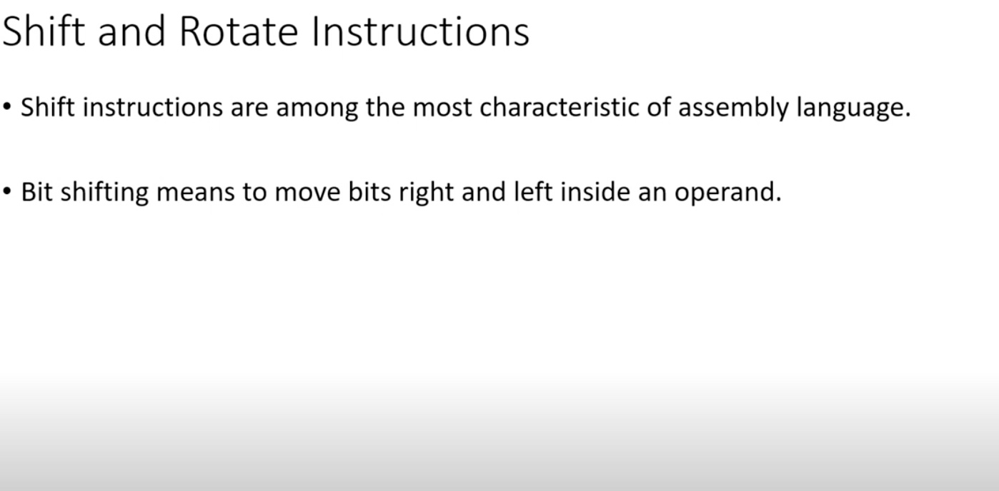

Slide 6
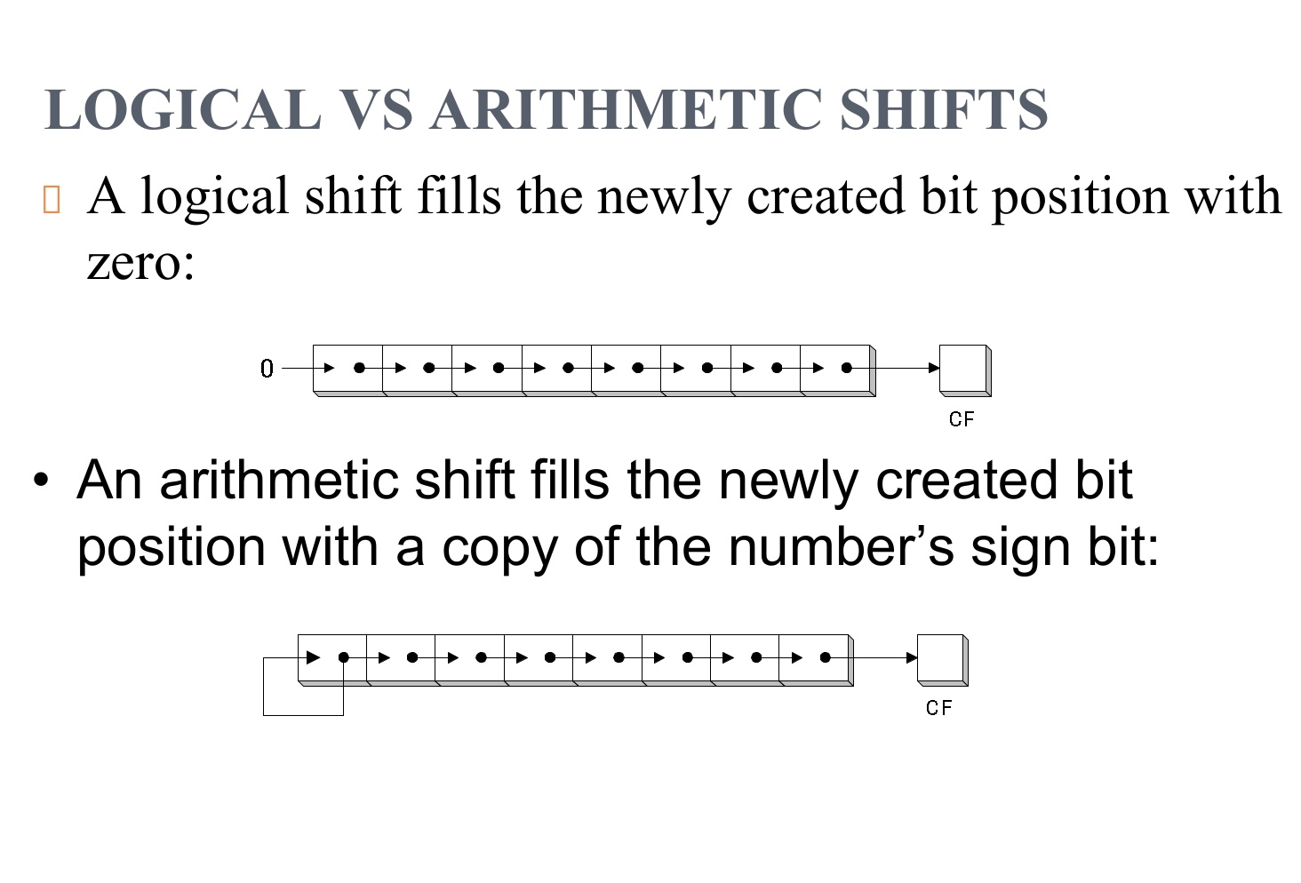

Slide 7
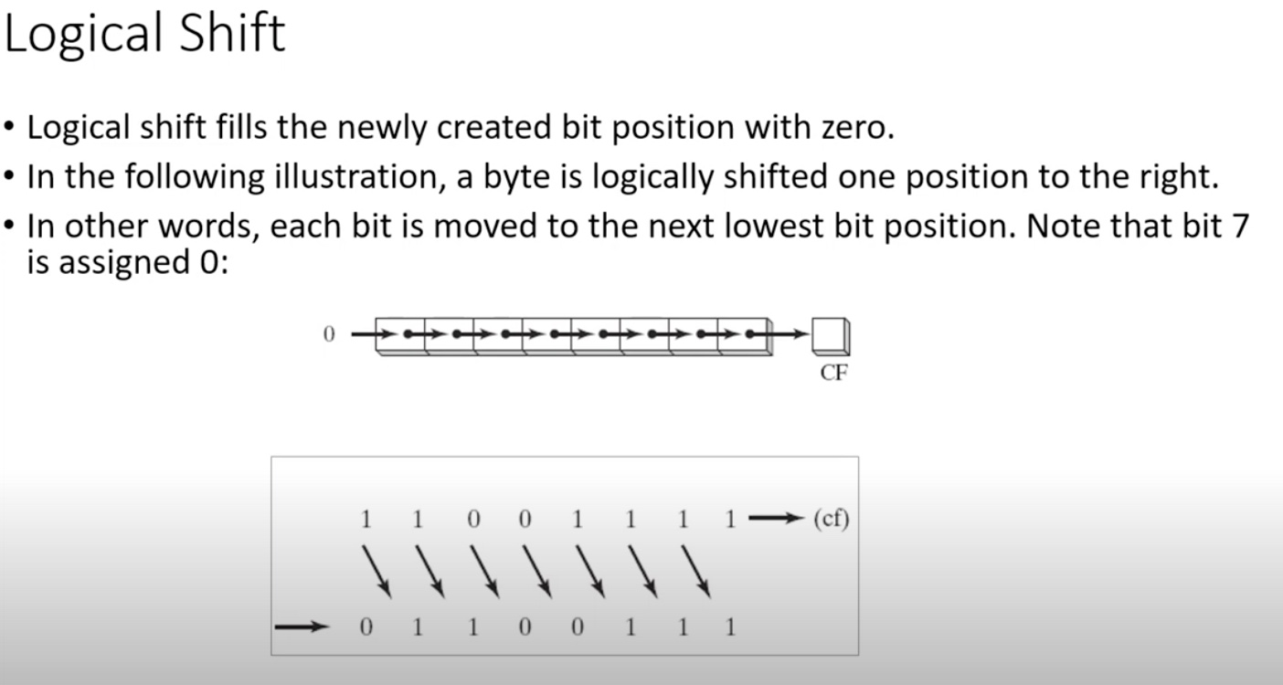

Slide 8
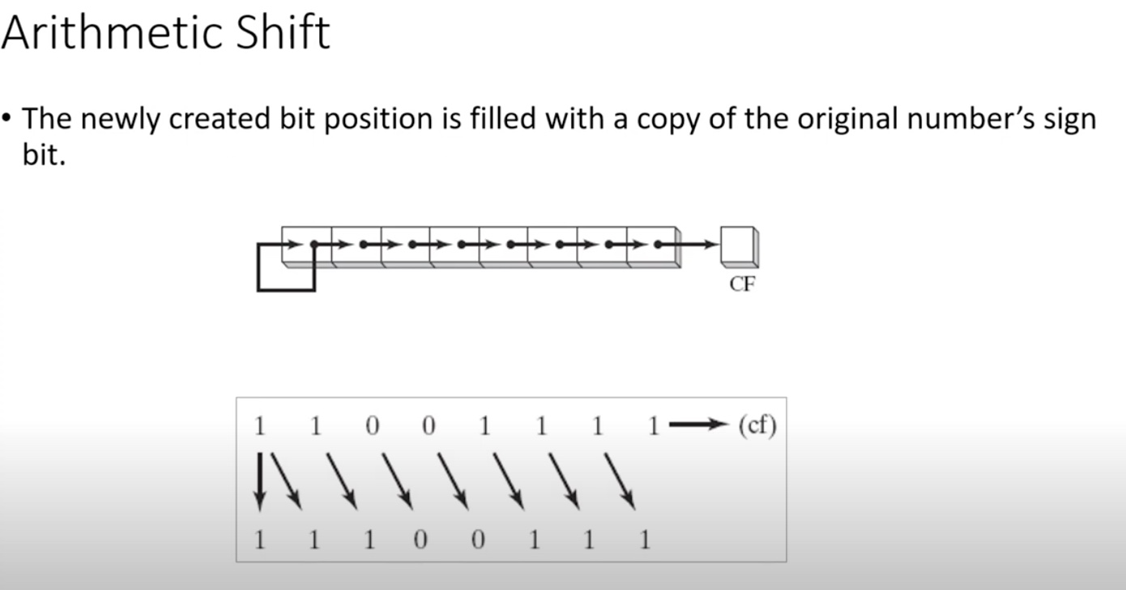

Slide 9
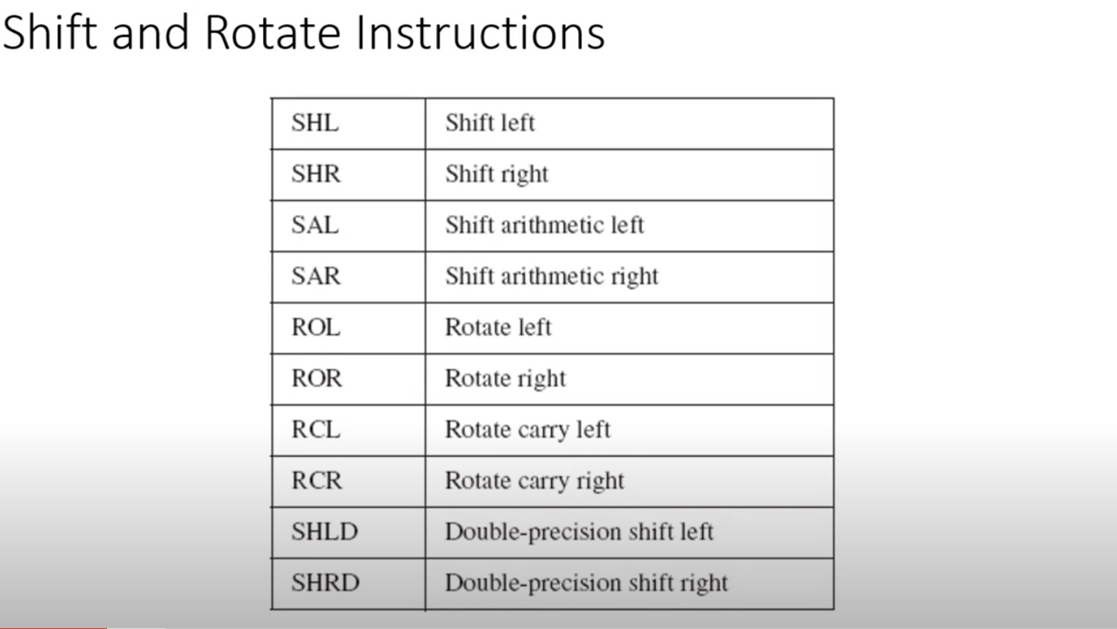

Slide 10
1.) Shift Left / Shift Logical Left (SHL)

Slide 11
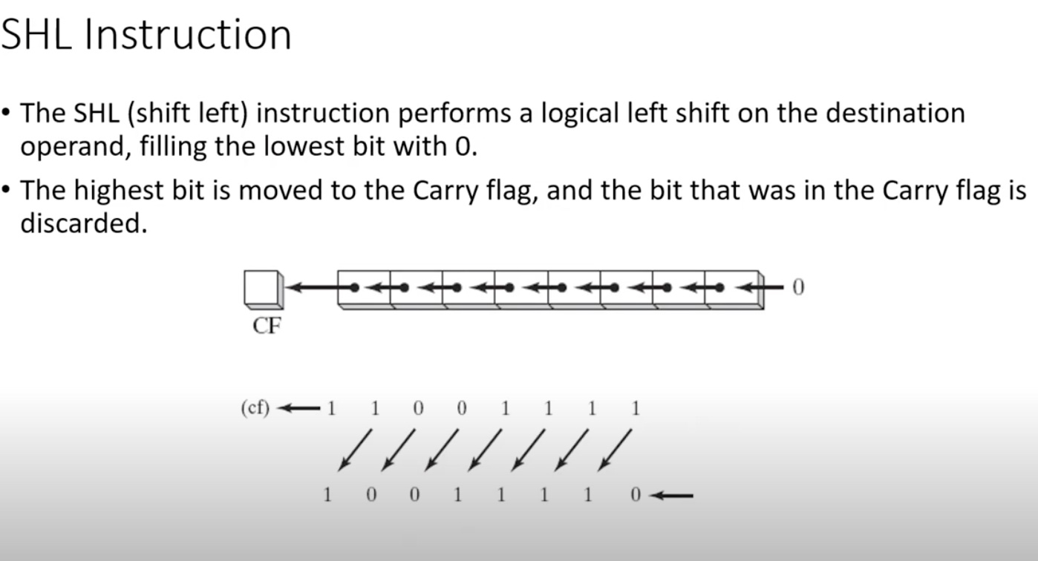
1.) Shift Left/ Shift Logical Left (SHL)

Slide 12
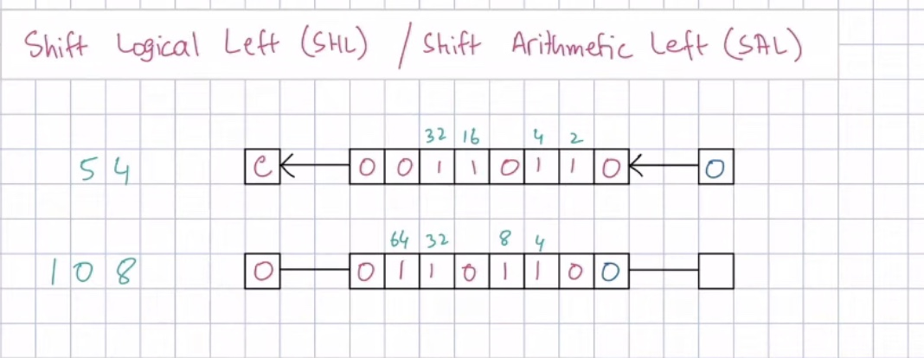
1.) Shift Left/ Shift Logical Left (SHL)

Slide 13
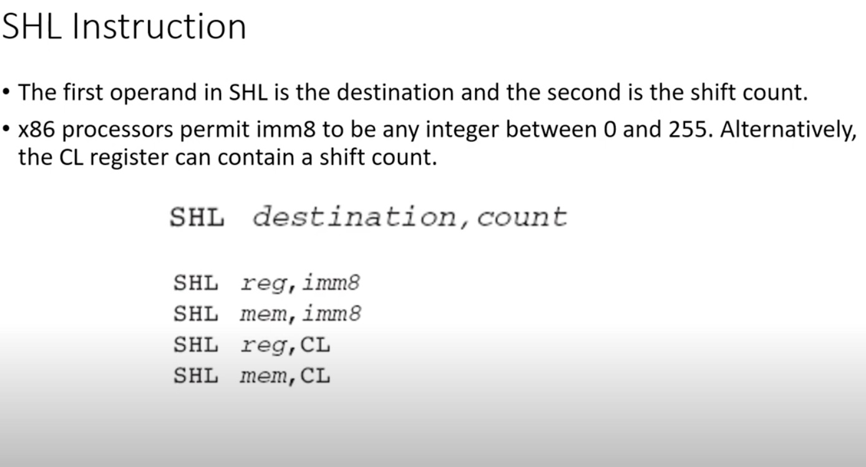
1.) Shift Left/ Shift Logical Left (SHL)

Slide 14
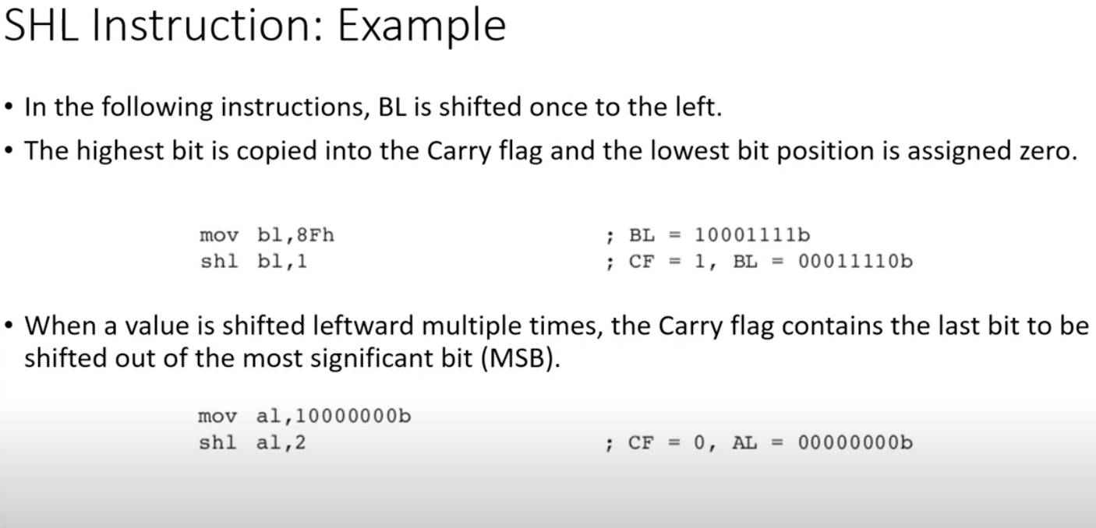
1.) Shift Left/ Shift Logical Left (SHL)

Slide 15
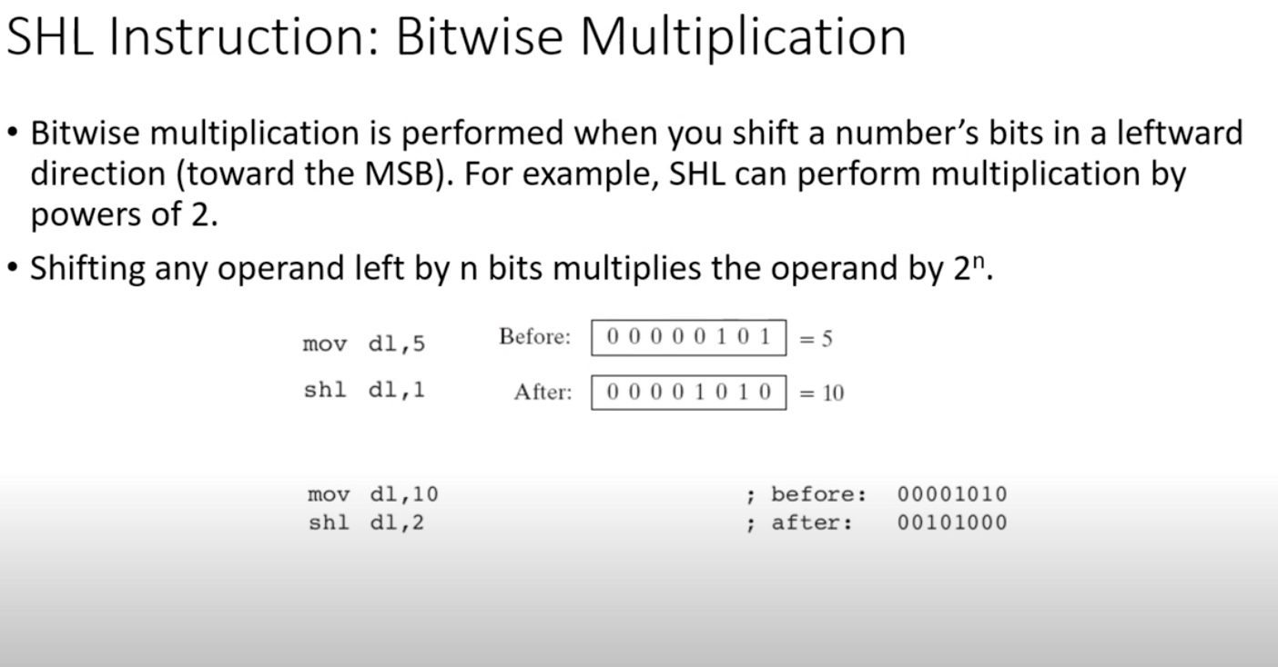
1.) Shift Left/ Shift Logical Left (SHL)

Slide 16
2.) Shift Right / Shift Logical Right (SHR)

Slide 17
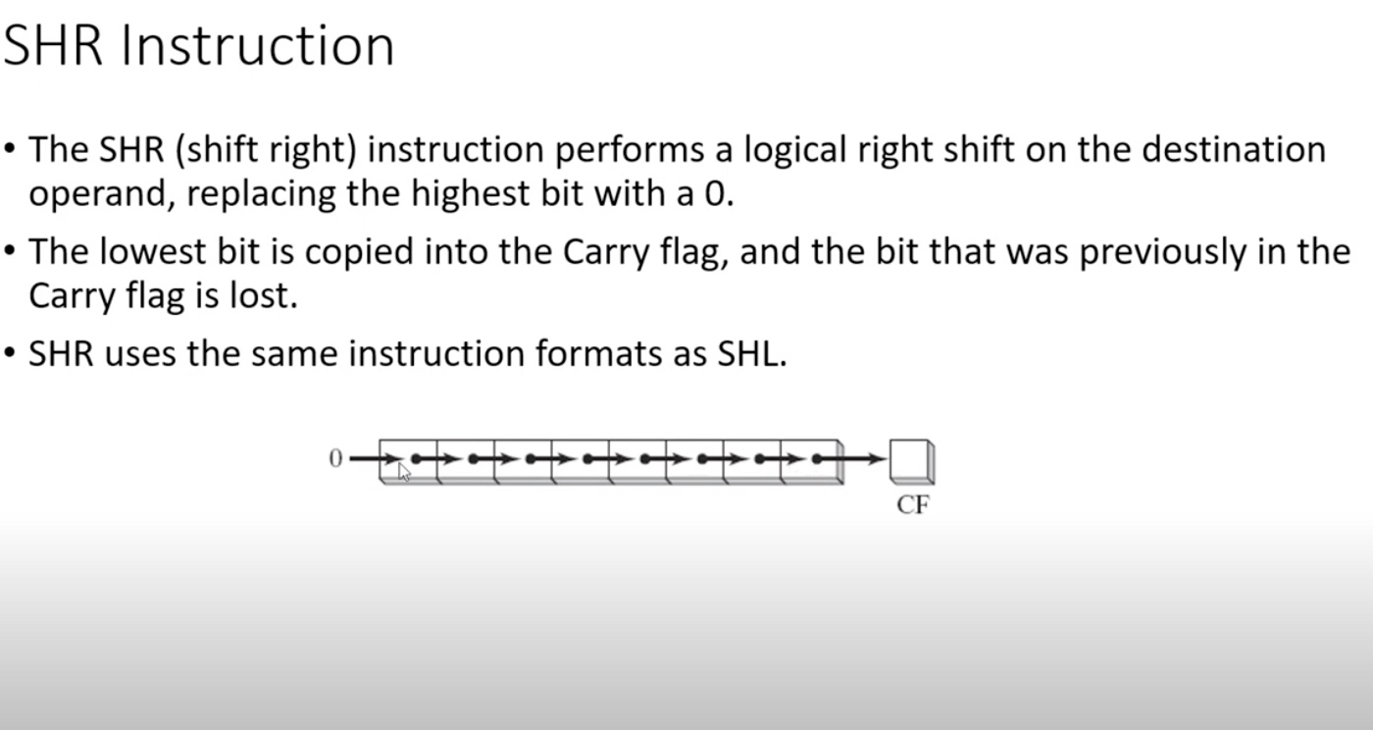
2.) Shift Right / Shift Logical Right (SHR)

Slide 18
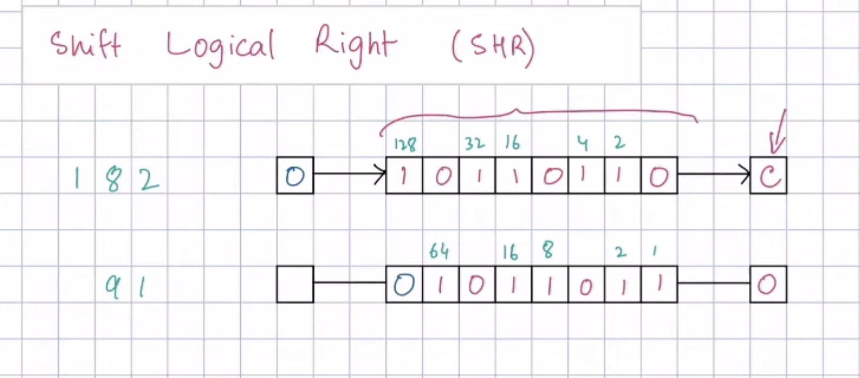
2.) Shift Right / Shift Logical Right (SHR)

Slide 19
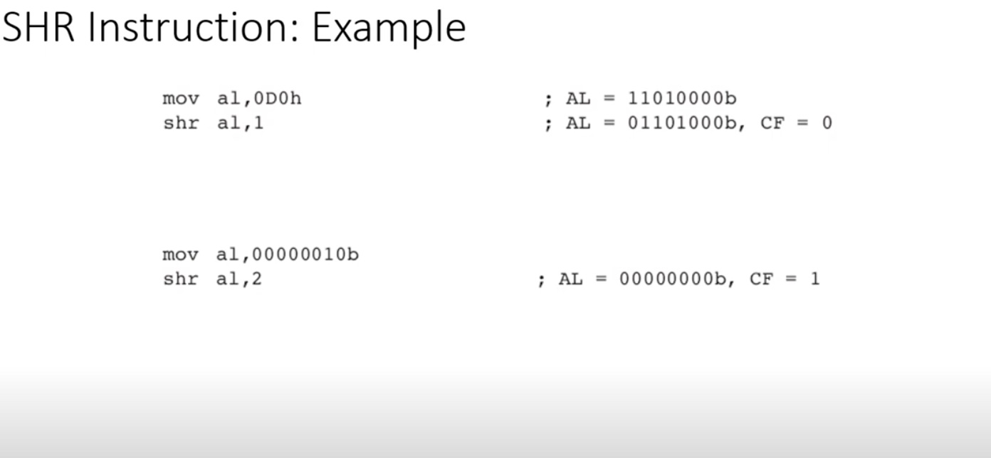
2.) Shift Right / Shift Logical Right (SHR)

Slide 20
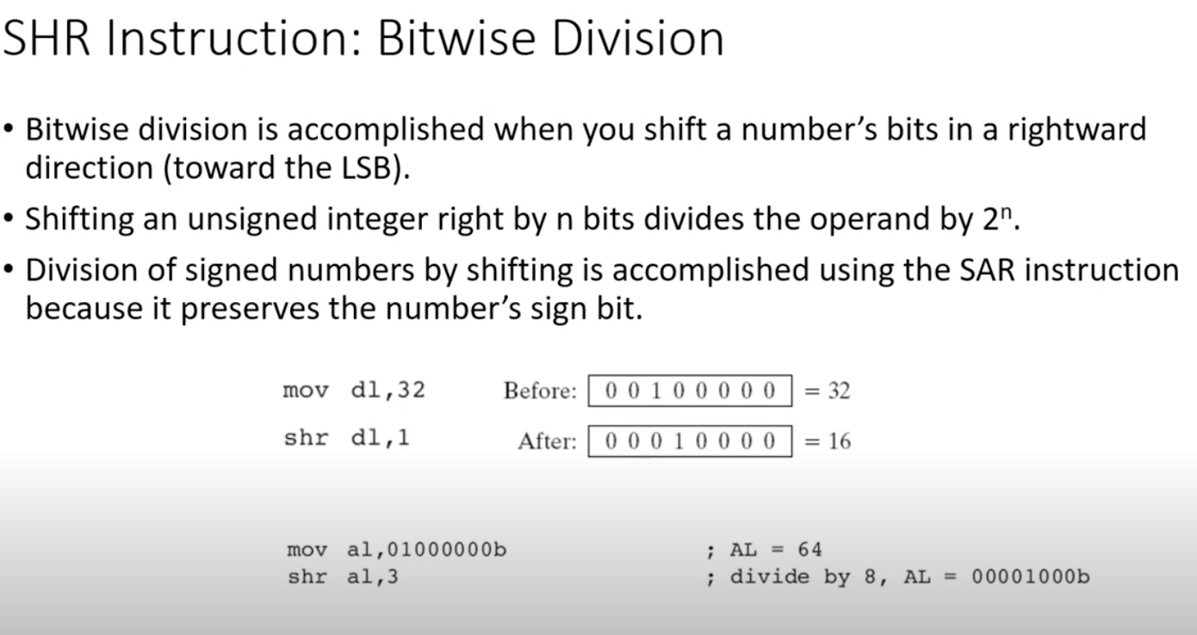
2.) Shift Right / Shift Logical Right (SHR)

Slide 21
Announcement :
Quiz 3 in next week , second class:
Date: (30-4-2025) / Wednesday
Syallabus : Chap 4 (Shifting and Rotation)

Slide 22
End of Lecture

